Slide 1
Configuration Guide
(IDE – Eclipse 3.5 Default Preferences)
2009. 07. 20
CODELABOR
Shin Sang Jae (codelabor@gmail.com)

Slide 2
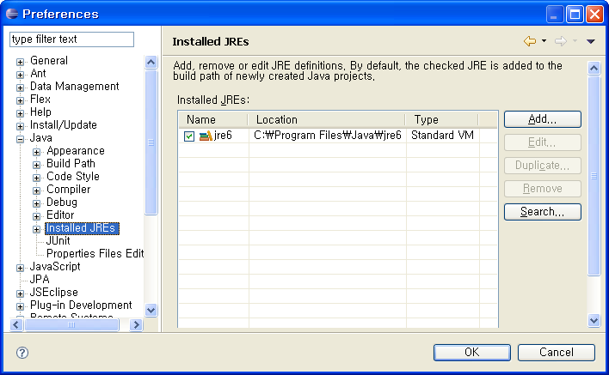
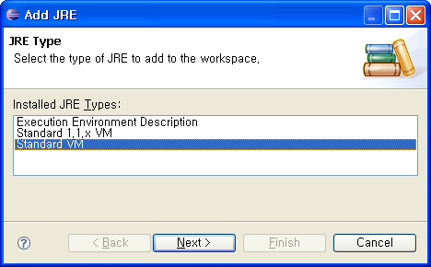
JREs 1/2
Installed JREs
Windows ＞ Preferences ＞ Java ＞ Installed JREs
Add

Slide 3
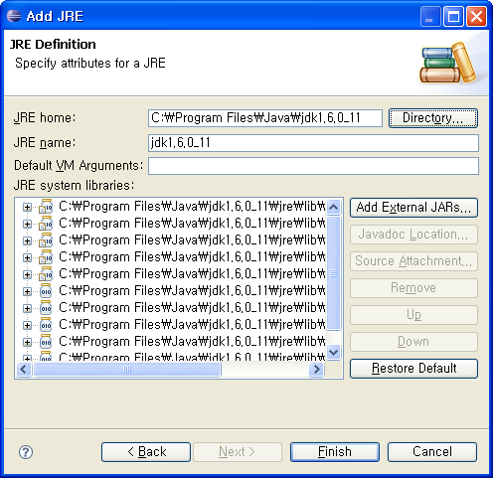
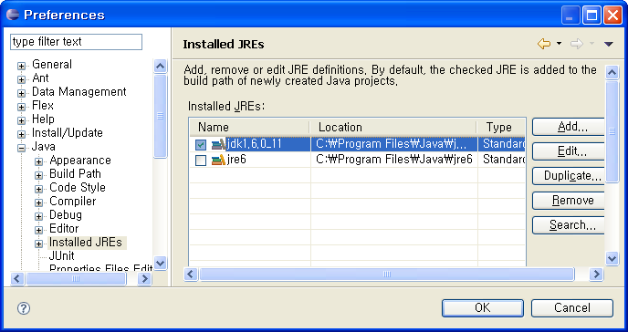
JREs 2/2
Installed JREs
Check jdk1.6.0_11

Slide 4
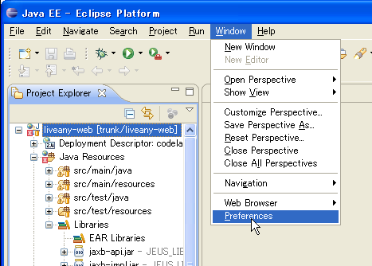
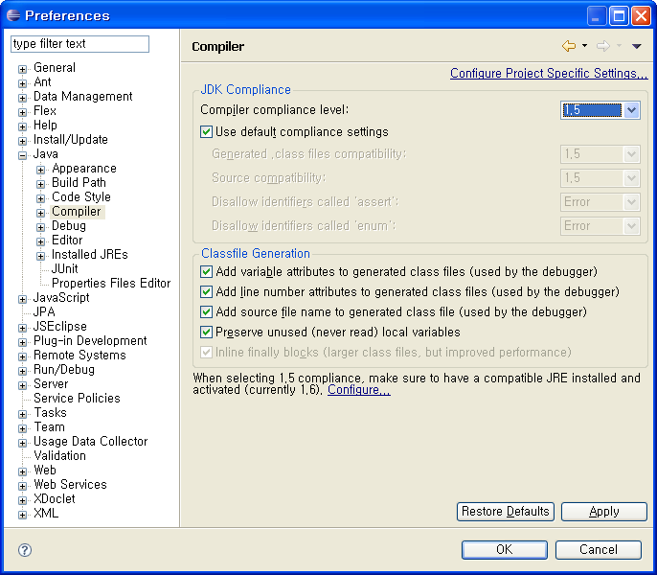
Compiler compliance
Compiler Compliance
Windows ＞ Preferences ＞ Java ＞ Compiler
Compiler compliance level: 1.5

Slide 5
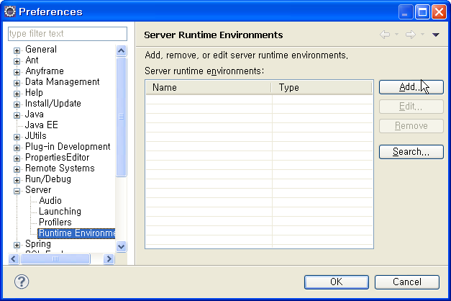
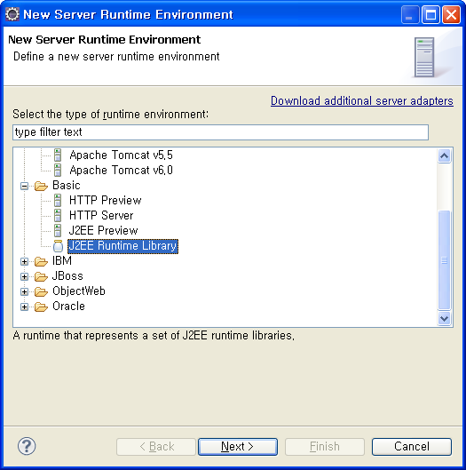
Runtime Environment 1/3
Runtime Environment
Windows ＞ Preferences ＞ Server > Runtime Environment
Add

Slide 6
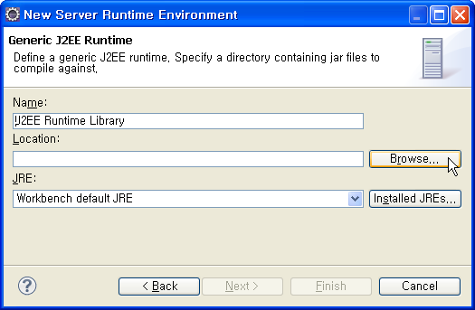
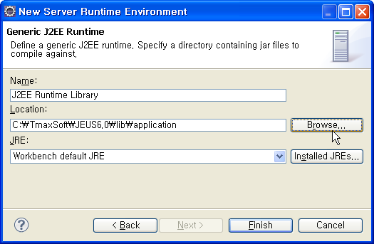
Runtime Environment 2/3
Runtime Environment
Set WAS Library
Location: C:/TmaxSoft/JEUS6.0/lib/application

Slide 7
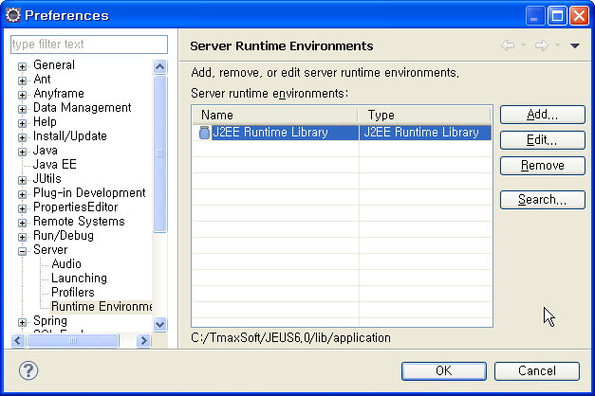
Runtime Environment 3/3
Runtime Environment

Slide 8
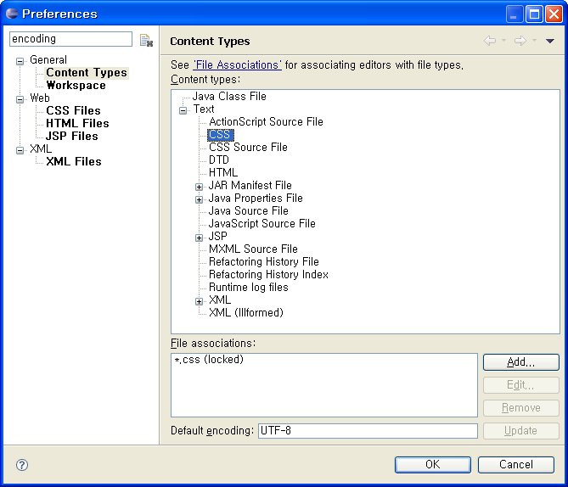
Encoding 1/2
Encoding
Windows ＞ Preferences
Search Keyword: encoding
CSS: UTF-8
HTML: UTF-8
Java Properties File: ISO-8859-1
Java Source File: UTF-8
Java Script Source File: UTF-8
JSP: UTF-8

Slide 9
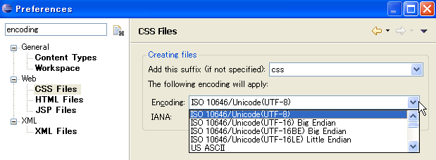
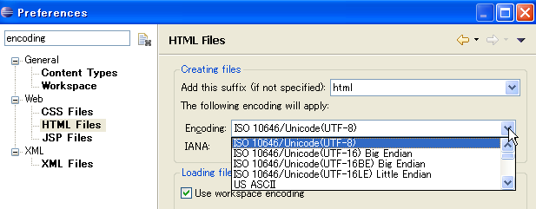
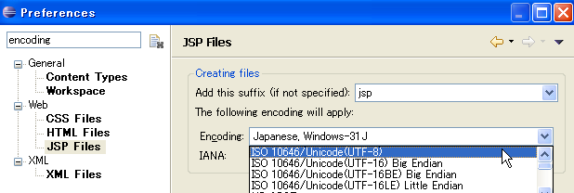
Encoding 2/2
Encoding
CSS: ISO 10646/Unicode(UTF-8)
HTML: ISO 10646/Unicode(UTF-8)
JSP: ISO 10646/Unicode(UTF-8)

Slide 10
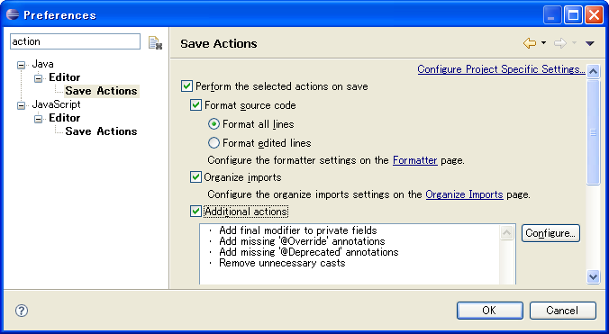
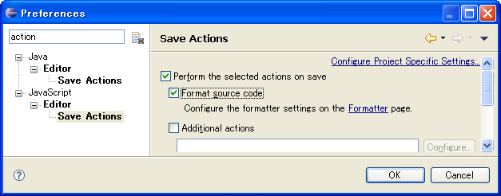
Save Action
Save Action
Windows ＞ Preferences
Search Keyword: action
Format source code
Organize imports
Additional actions
Format source code

Slide 11
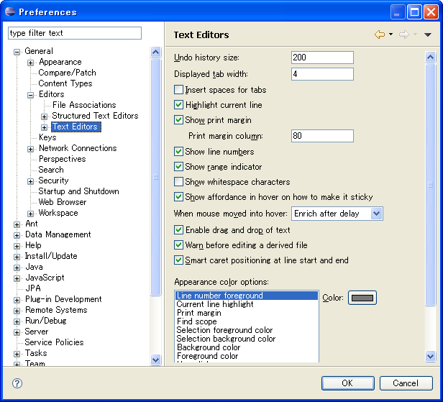
Text Editors
Text Editong
Windows ＞ Preferences > General > Editors > Text Editors
Show print margin
Show line numbers

Slide 12
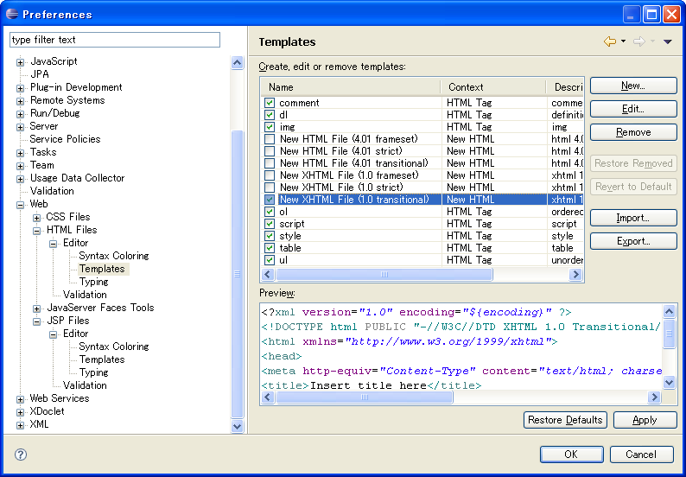
Template 1/2
New File Template
Windows ＞ Preferences > Web > HTML Files > Editor > Template
HTML: New XHTML File (1.0 transitional)

Slide 13
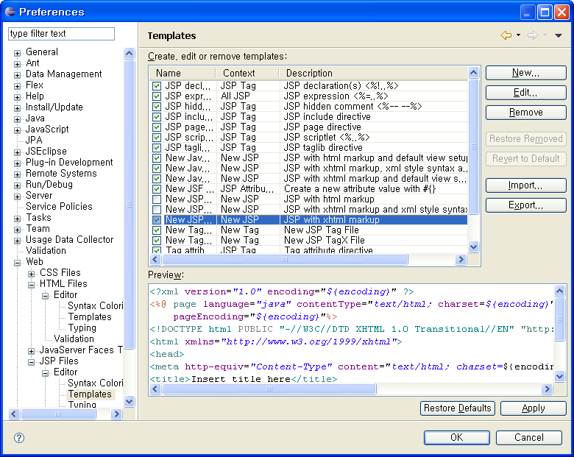
Template 2/2
New File Template
Windows ＞ Preferences > Web > JSP Files > Editor > Template
JSP: New JSP File (xhtml)

Slide 14
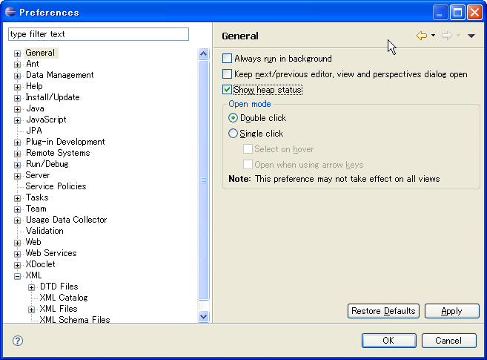

Heap Status
Heap Status
Windows ＞ Preferences > General
Show heap status

